Slide 1
Local Universe Galaxy Survey:
Magnitude and Density Profile
Junhua Yang, Ziyao Xiong
25/10/2024

Slide 2
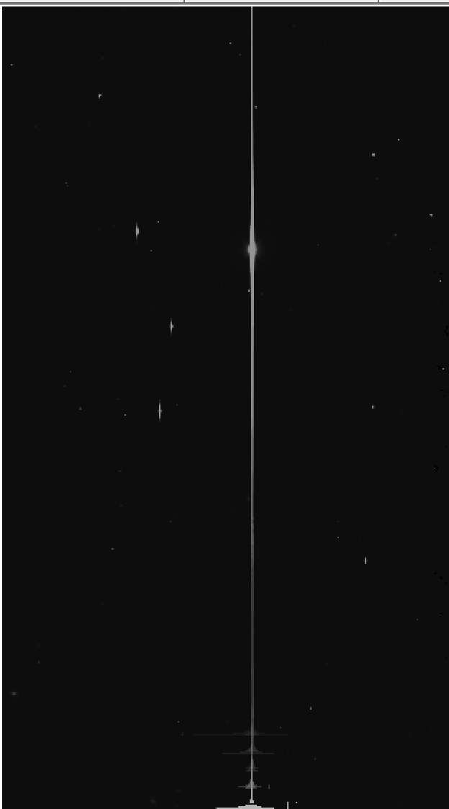
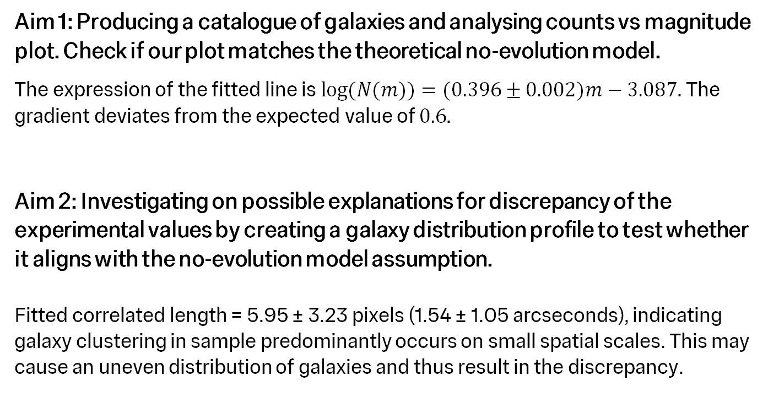
Abstract
Aims and key results
Aim 1: Producing a catalogue of galaxies and analysing counts vs magnitude plot. Check if our plot matches the theoretical no-evolution model.
The expression of the fitted line is$log⁡(N(m))=(0.396±0.002)m−3.087$. The gradient deviates from the expected value of $0.6$.
Aim 2: Investigating on possible explanations for discrepancy of the experimental values by creating a galaxy distribution profile to test whether it aligns with the no-evolution model assumption.
Fitted correlated length = 5.95 ± 3.23 pixels (1.54 ± 1.05 arcseconds), indicating galaxy clustering in sample predominantly occurs on small spatial scales. This may cause an uneven distribution of galaxies and thus result in the discrepancy.

Slide 3
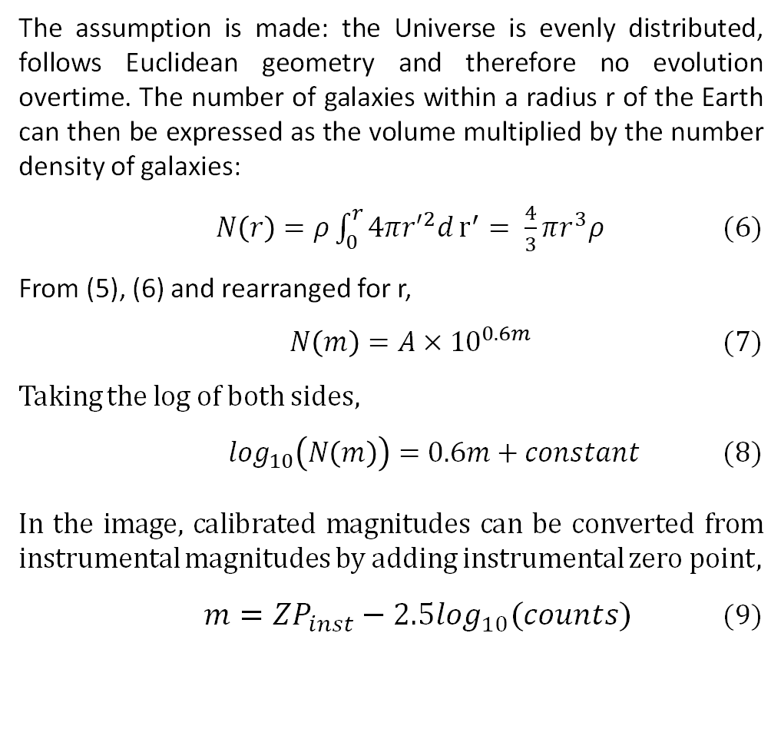
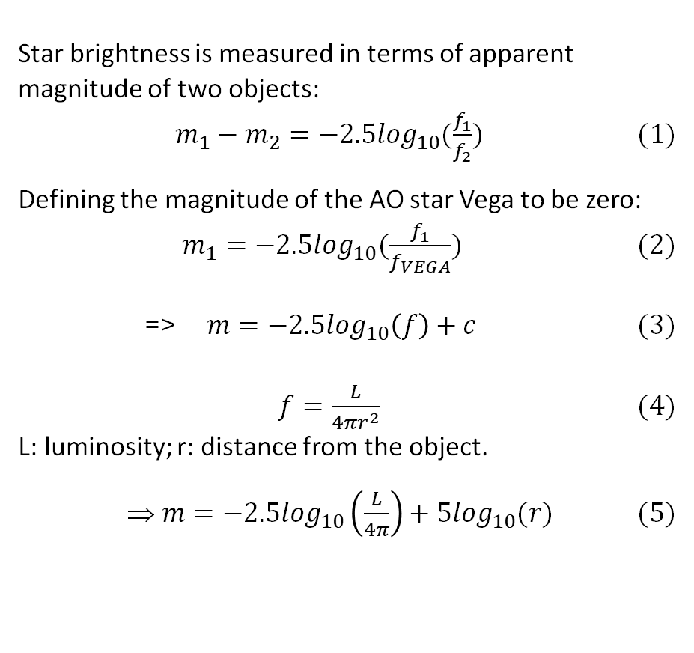
Theory
No-evolution model
The assumption is made: the Universe is evenly distributed, follows Euclidean geometry and therefore no evolution overtime. The number of galaxies within a radius r of the Earth can then be expressed as the volume multiplied by the number density of galaxies:
$N\left(r\right)=ρ\int_{0}^{r}{4π{r′}^{2}d}r^{′}= \frac{4}{3}πr^{3}ρ$ (6)
From (5), (6) and rearranged for r,
$N\left(m\right)=A×{10}^{0.6m}$ (7)
Taking the log of both sides,
$\log_{10}\left(N\left(m\right)\right)=0.6m+constant$ (8)
In the image, calibrated magnitudes can be converted from instrumental magnitudes by adding instrumental zero point,
$m={ZP}_{inst}−2.5\log_{10}(counts)$ (9)
Star brightness is measured in terms of apparent magnitude of two objects:
$m_{1}−m_{2}=−2.5\log_{10}(\frac{f_{1}}{f_{2}})$ (1)
Defining the magnitude of the AO star Vega to be zero:
$m_{1}=−2.5\log_{10}(\frac{f_{1}}{f_{VEGA}})$ (2)
=> $m=−2.5\log_{10}\left(f\right)+c$ (3)
$f=\frac{L}{4πr^{2}}$ (4)
L: luminosity; r: distance from the object.
$m=−2.5\log_{10}\left(\frac{L}{4π}\right)+5\log_{10}(r)$ (5)

Slide 4
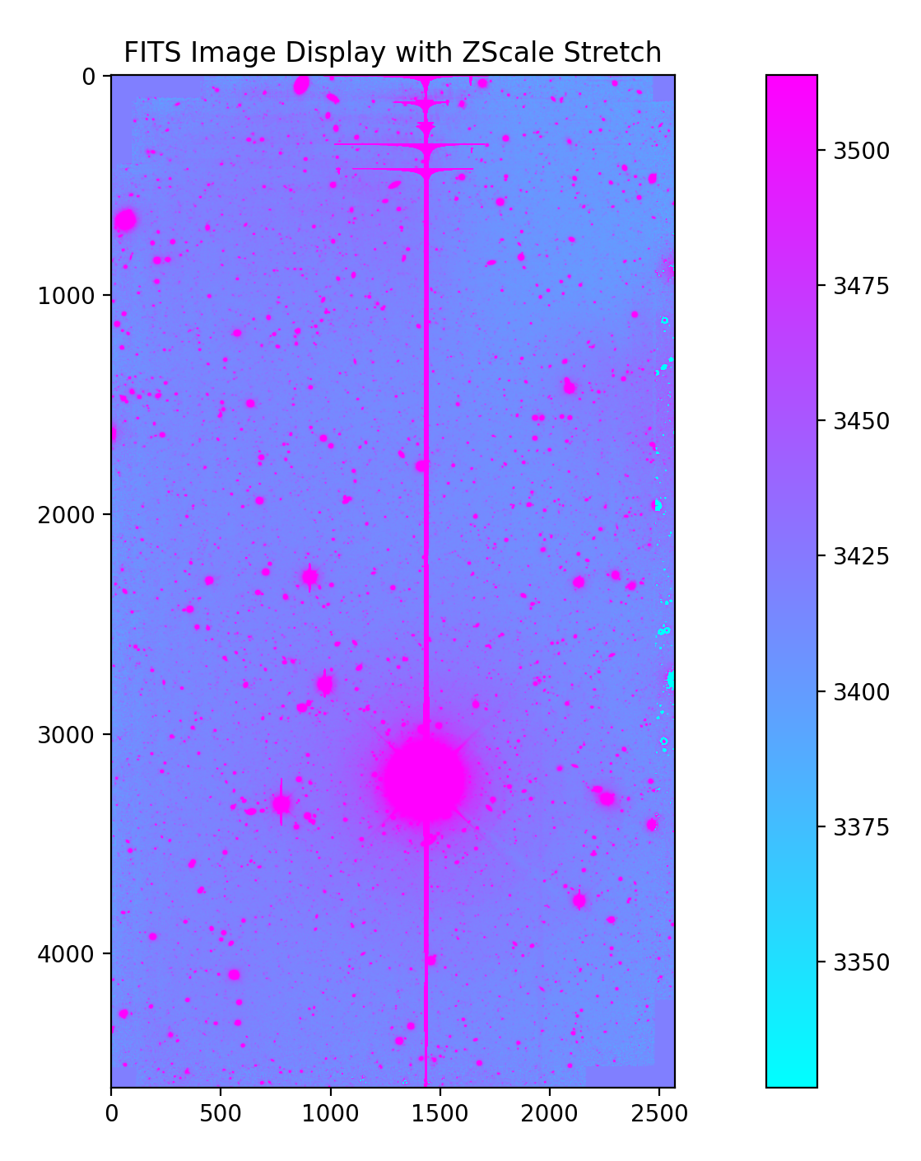
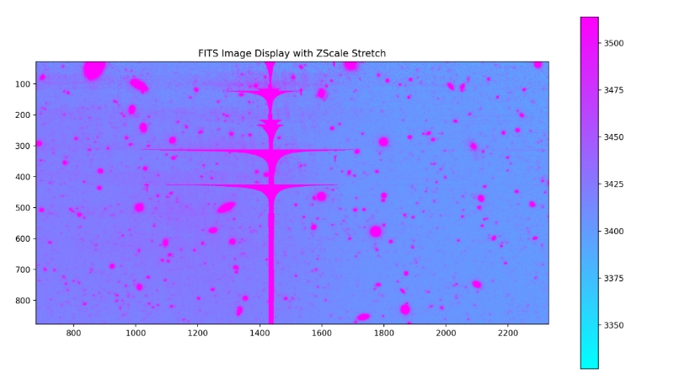
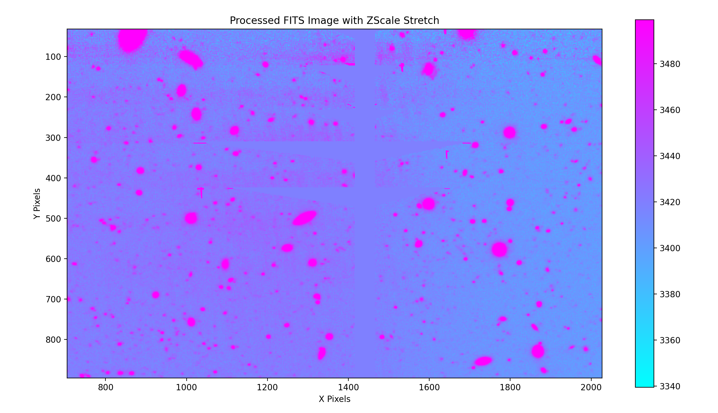
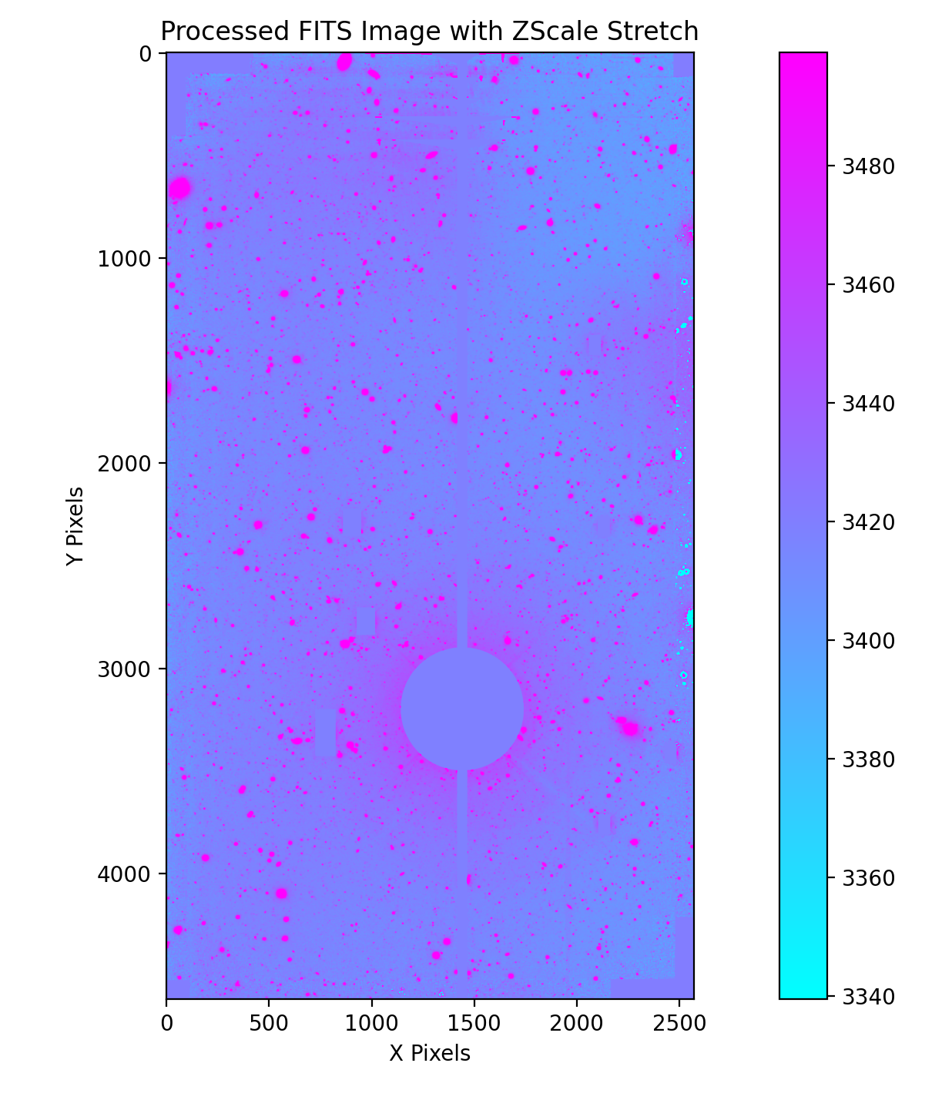
Method
Masking stars affected by blooming
np.nan

Slide 5
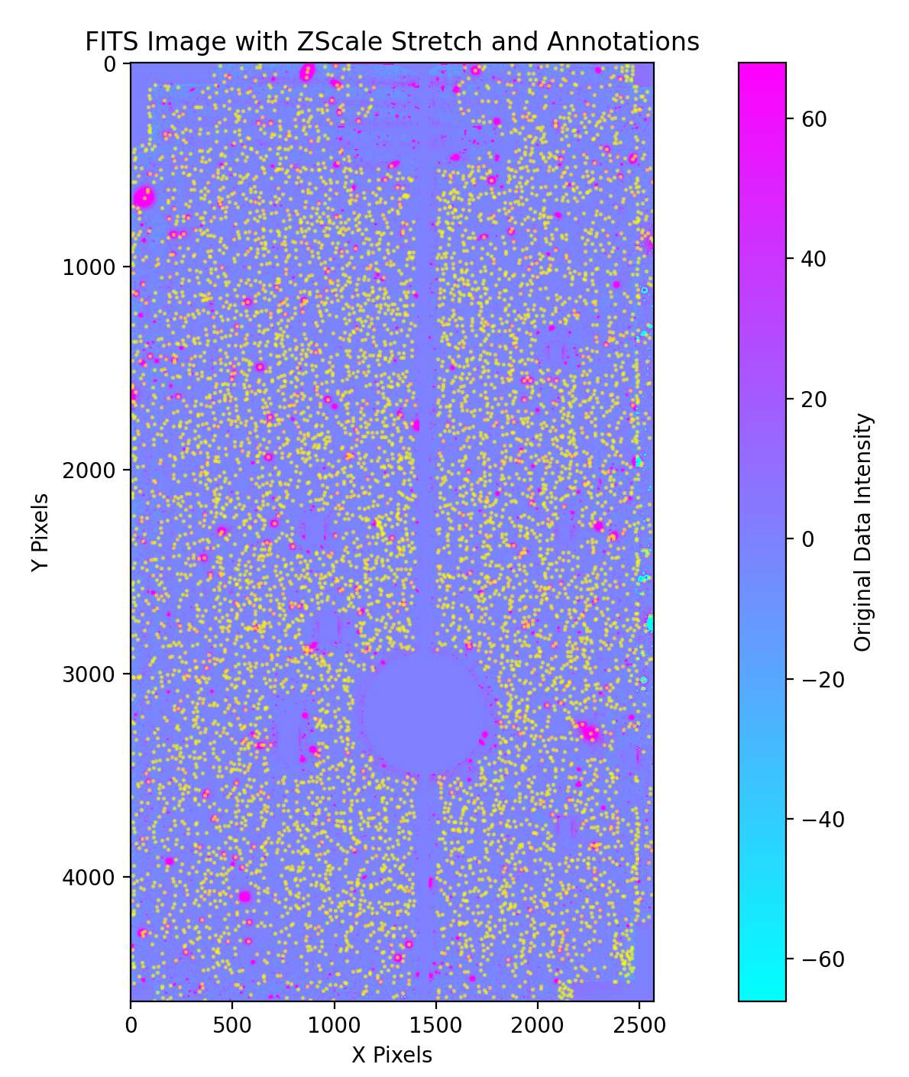
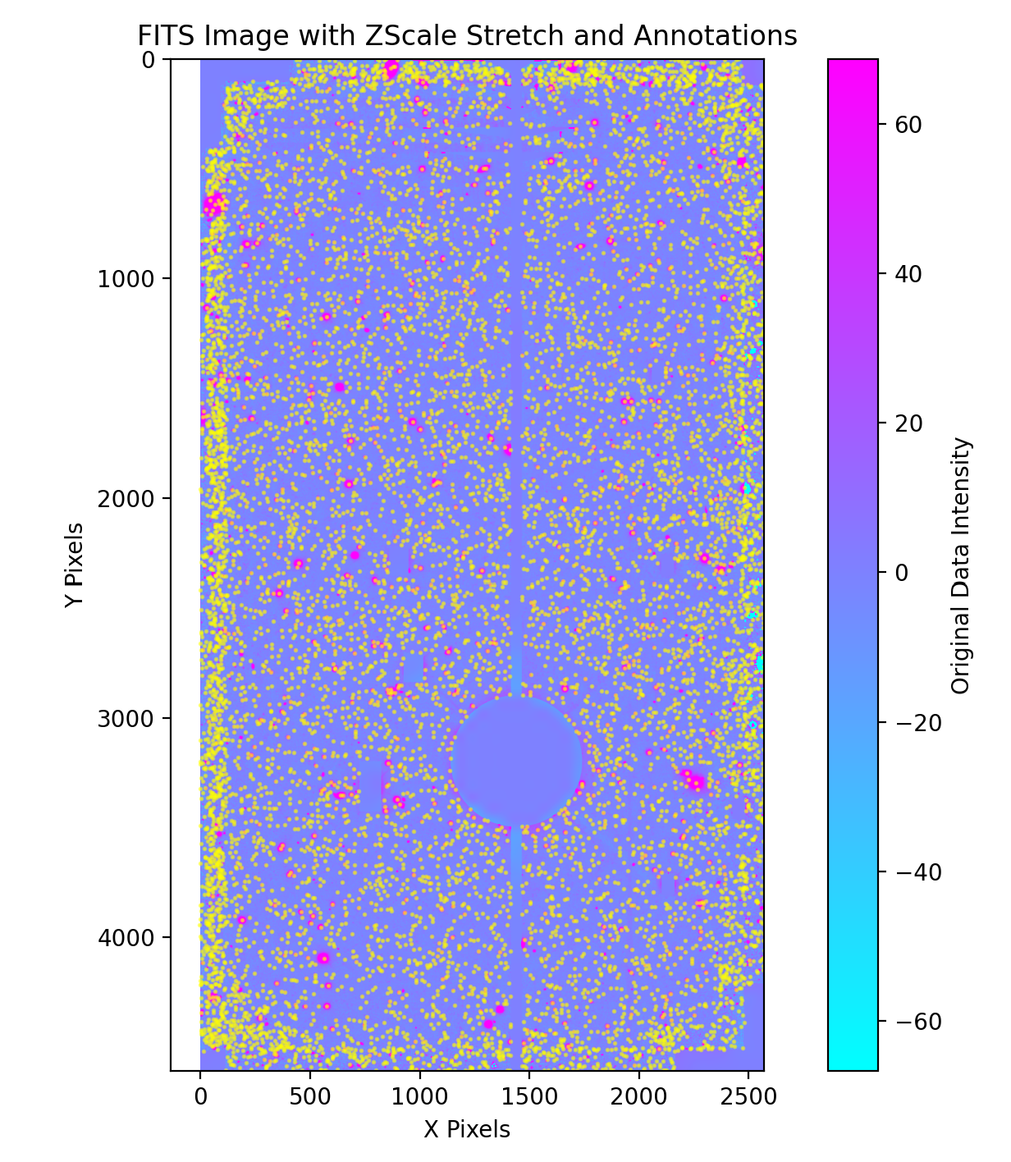
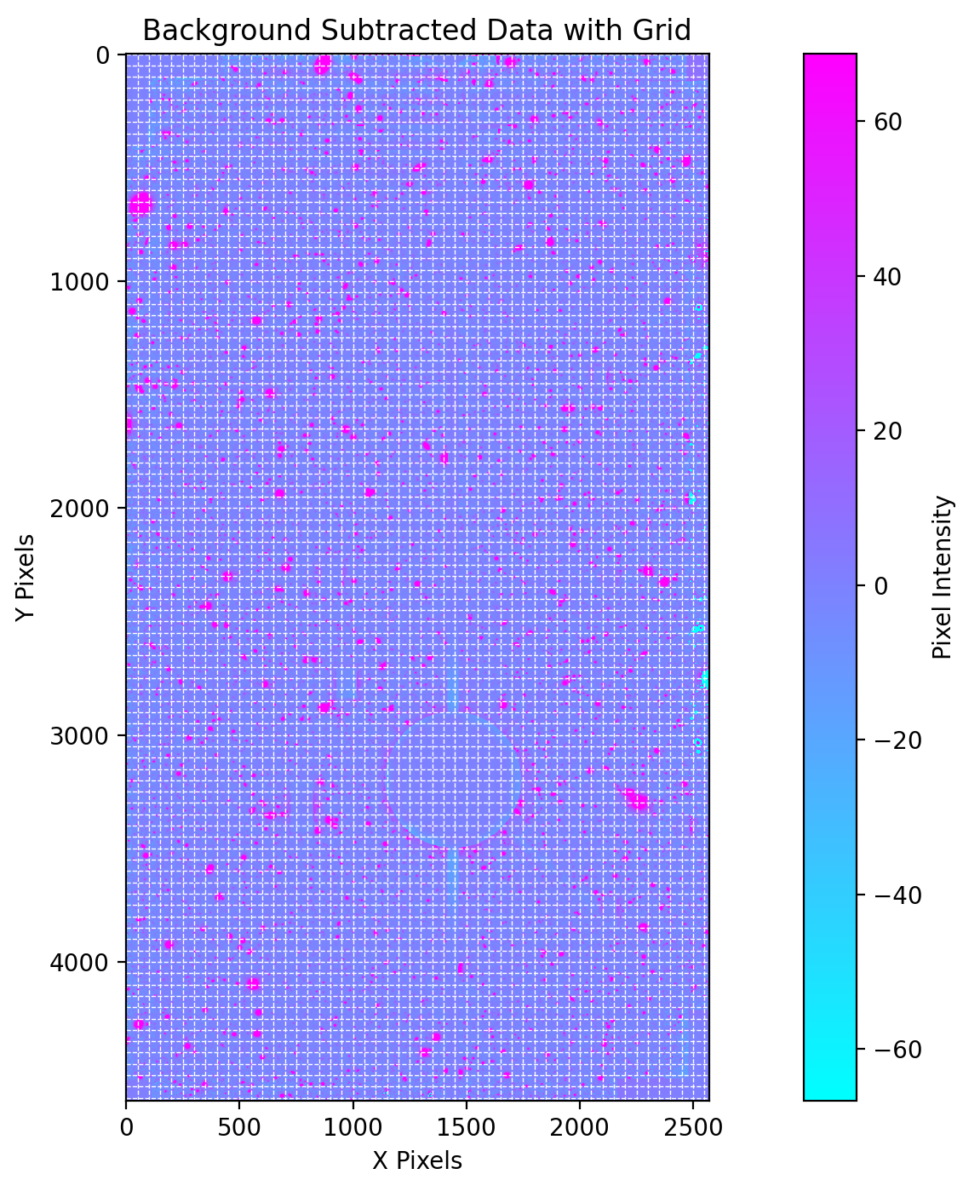
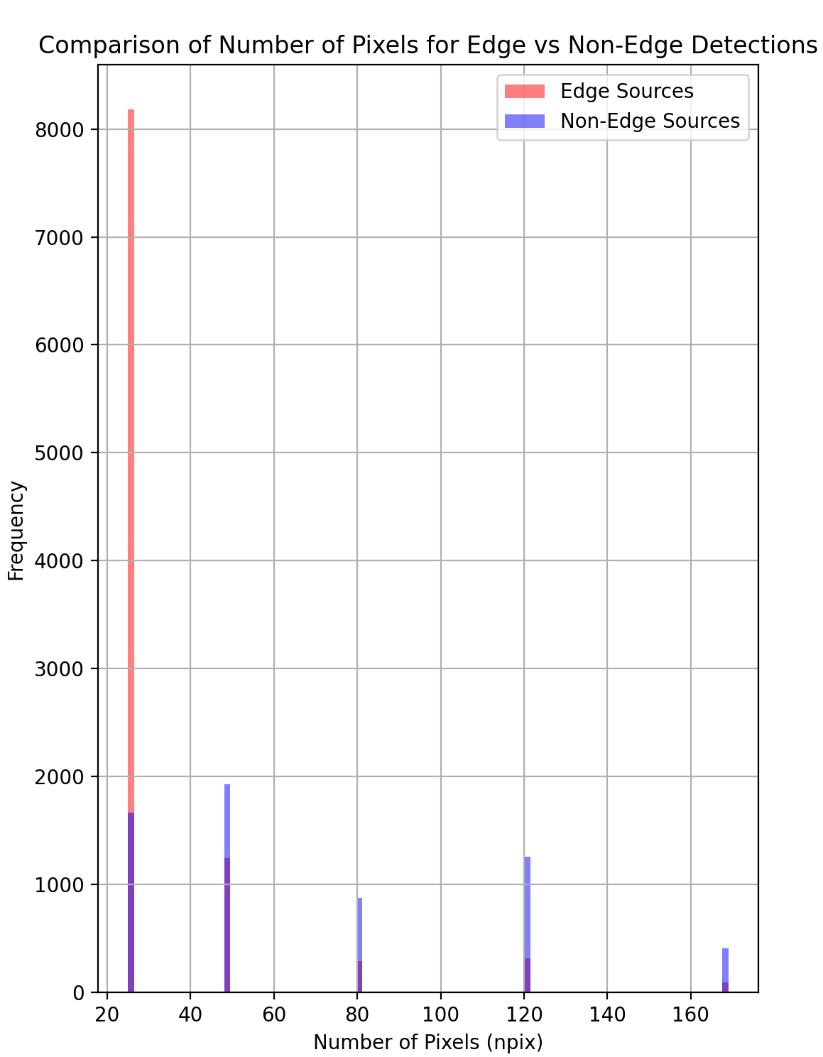
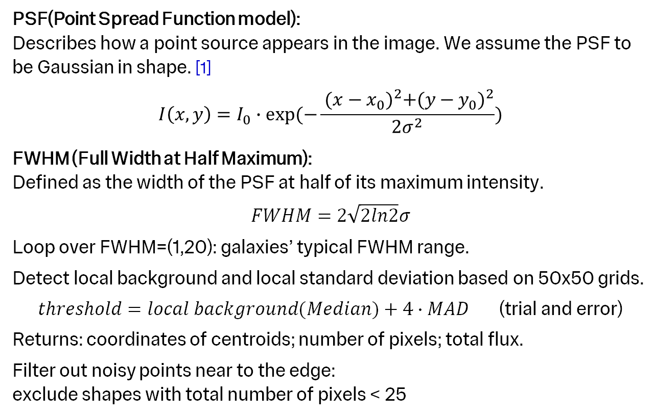
Method
PSF & FWHM
PSF(Point Spread Function model):
Describes how a point source appears in the image. We assume the PSF to be Gaussian in shape. [1]
$$I\left(x,y\right)=I_{0}∙exp(−\frac{ {(x−x_{0})}^{2}+{(y−y_{0})}^{2}}{2σ^{2}})$$
FWHM (Full Width at Half Maximum):
Defined as the width of the PSF at half of its maximum intensity.
$$FWHM=2\sqrt{2ln2}σ$$
Loop over FWHM=(1,20): galaxies’ typical FWHM range.
Detect local background and local standard deviation based on 50x50 grids.
$threshold=local background(Median)+4∙MAD$ (trial and error)
Returns: coordinates of centroids; number of pixels; total flux.
Filter out noisy points near to the edge:
exclude shapes with total number of pixels < 25
REFERENCE [1]: Galaxy Number Counts from the Sloan Digital Sky Survey Commissioning Data, Yasuda et al., 2001, Astronomical Journal, 122, 1104

Slide 6
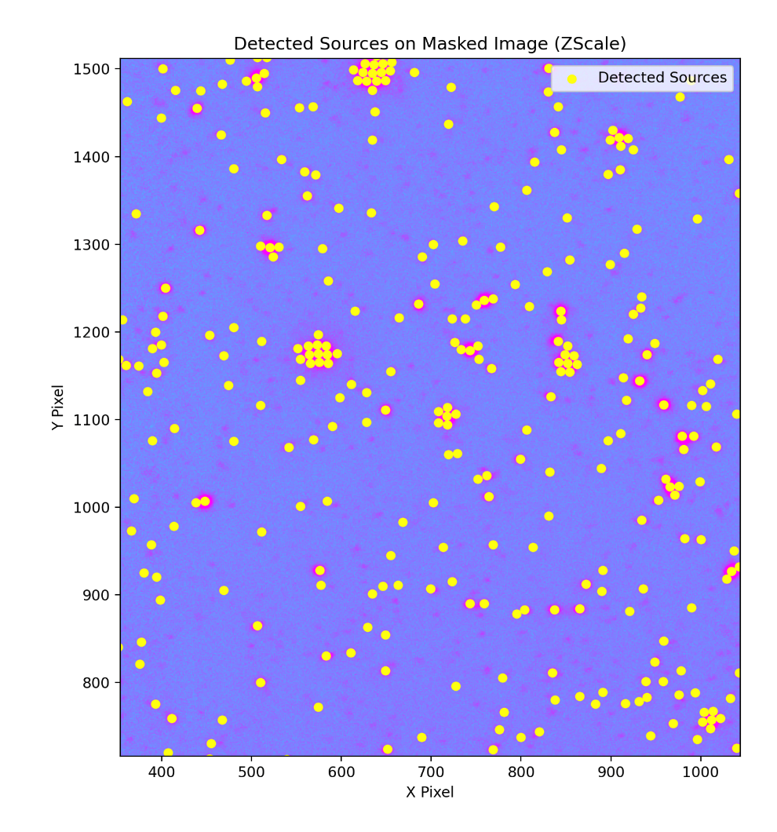
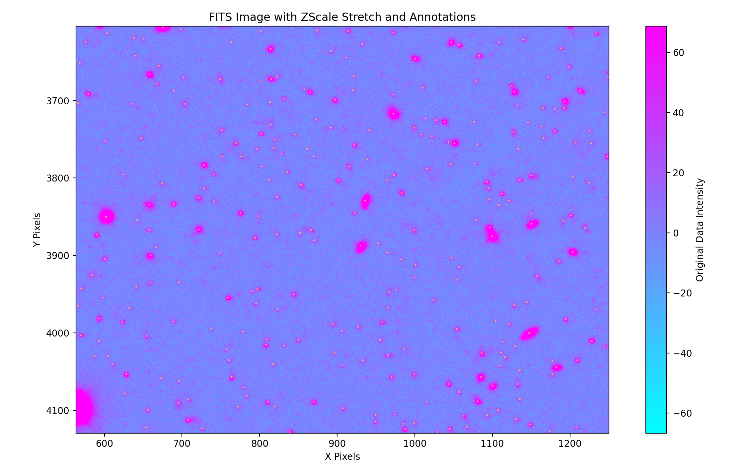
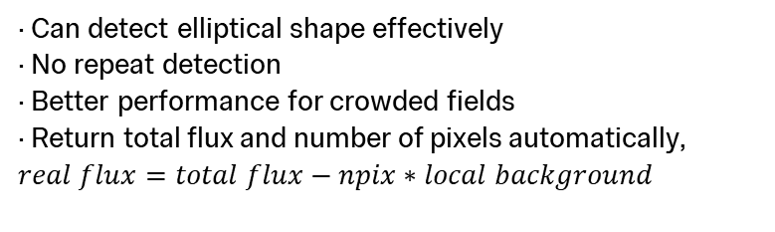
Method
Comparing with fixed aperture photometry
· Multiple detection of a single source or single detection of multiple sources
· Not optimal for faint sources and elliptical sources
· Large variance of detection when changing aperture size
· Can detect elliptical shape effectively
· No repeat detection
· Better performance for crowded fields
· Return total flux and number of pixels automatically, $real flux=total flux−npix∗local background$

Slide 7
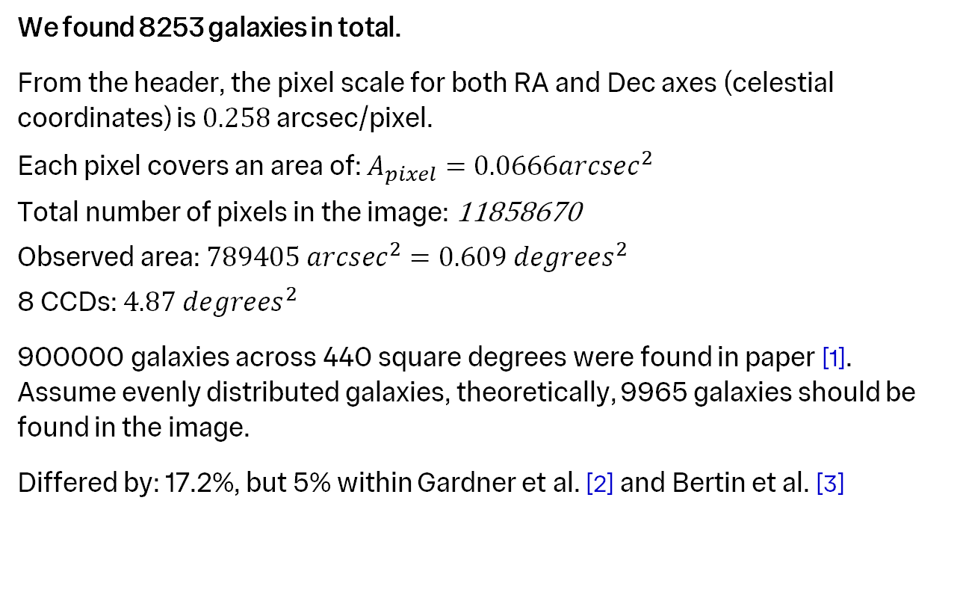
Data and Analysis
Galaxy statistics
We found 8253 galaxies in total.
From the header, the pixel scale for both RA and Dec axes (celestial coordinates) is $0.258$ arcsec/pixel.
Each pixel covers an area of: $A_{pixel}=0.0666{arcsec}^{2}$
Total number of pixels in the image: 11858670
Observed area: ${789405 arcsec}^{2}=0.609 {degrees}^{2}$
8 CCDs: $4.87 {degrees}^{2}$
900000 galaxies across 440 square degrees were found in paper [1].
Assume evenly distributed galaxies, theoretically, 9965 galaxies should be found in the image.
Differed by: 17.2%, but 5% within Gardner et al. [2] and Bertin et al. [3]
REFERENCE [1]: Yasuda, N., Fukugita, M., Narayanan, V. K., et al. (2001). Galaxy Number Counts from the Sloan Digital Sky Survey Commissioning Data. Astronomical Journal, 122, 1104-1124. DOI: 10.1086/322093
[2]: Gardner, J. P., Sharples, R. M., Carrasco, B. E., & Frenk, C. S. (1996). Galaxy counts and redshift distributions: Estimation from deep surveys. Monthly Notices of the Royal Astronomical Society, 282(1), 1-25. DOI: 10.1093/mnras/282.1.1
[3]: Bertin, E., & Dennefeld, M. (1997). Star-galaxy separation and galaxy counts: Analysis of deep imaging data. Astronomy & Astrophysics, 317, 43-55. Available at: https://adsabs.harvard.edu/abs/1997A%26A...317...43B

Slide 8
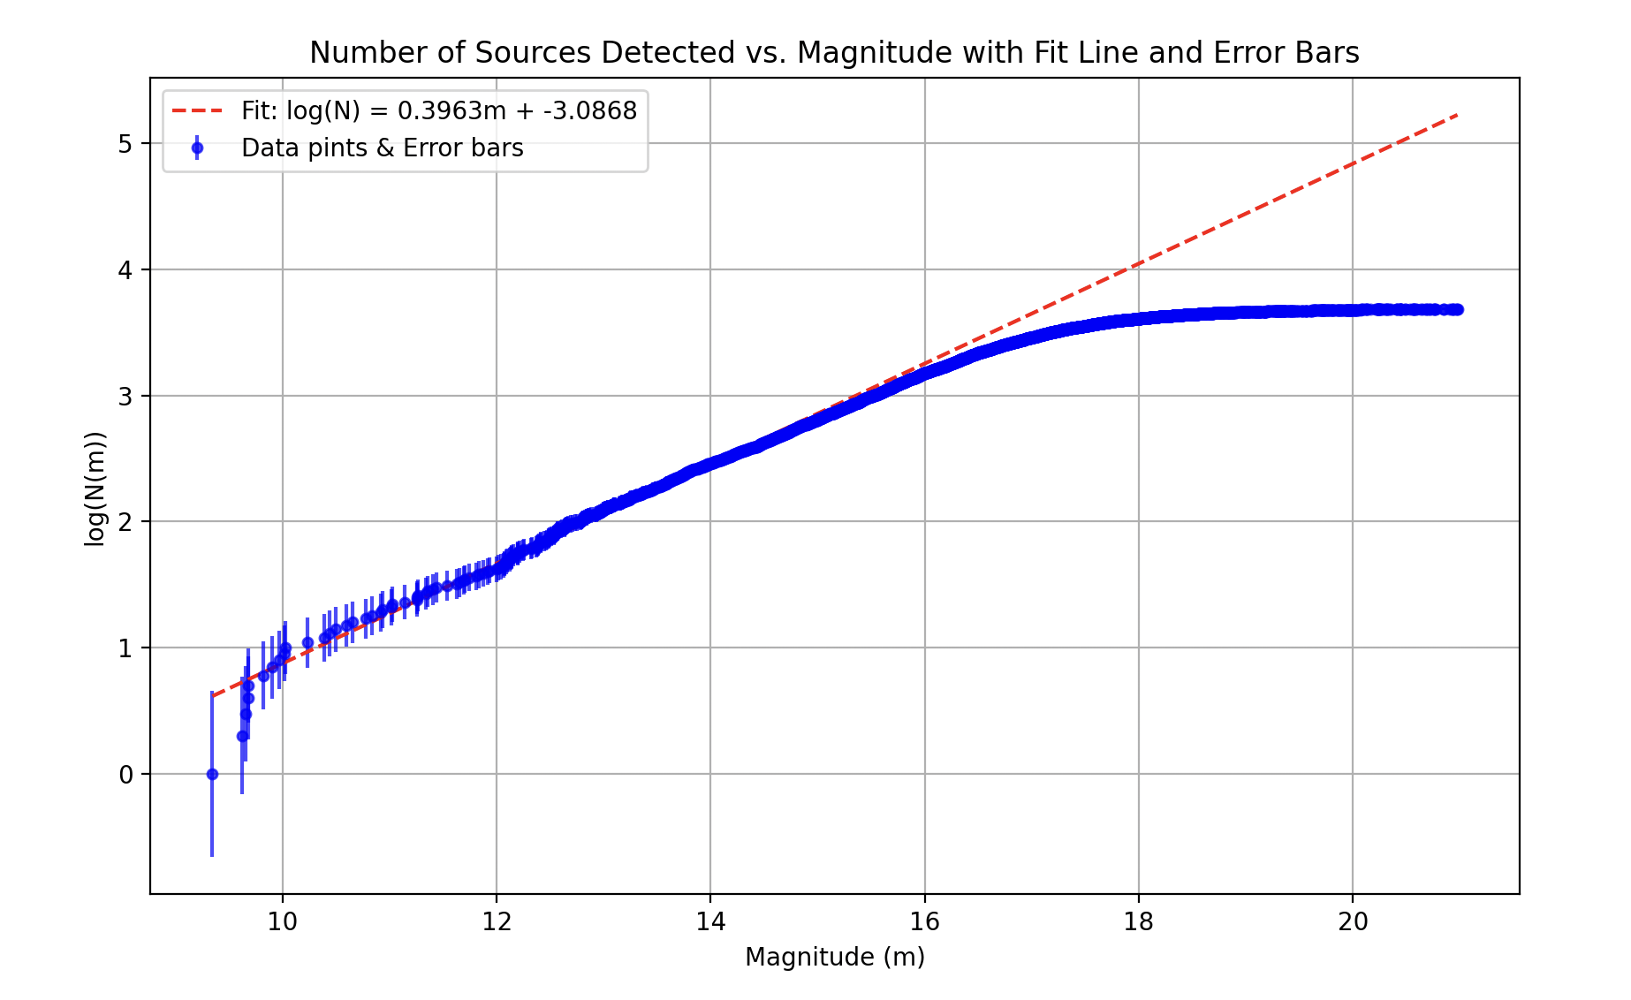
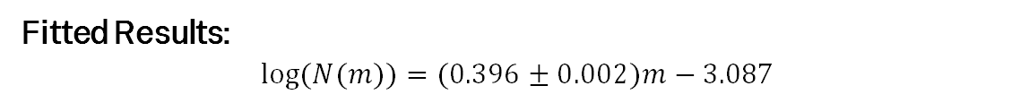
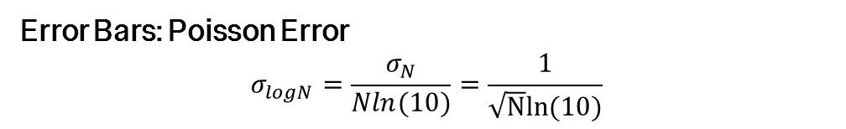
Data and Analysis
Number count plot
m<10: Steep curve
Overexposure of CCD: 16bit CCD can store maximum 65536 photons per pixel; non-linear when counts > 50000.
Unmasked stars.
Large error bars: large Poisson noise.
10<m<16: Use data in this range to fit a straight line
Fits the no-evolution model better.
m>16: Bending curve
Galaxies blend into the background and reach CCD's magnitude limit.
Fitted Results:
$$log⁡(N(m))=(0.396±0.002)m−3.087$$
Error Bars: Poisson Error
$$σ_{logN}=\frac{σ_{N}}{Nln(10)}=\frac{1}{\sqrt{N}ln⁡(10)}$$

Slide 9
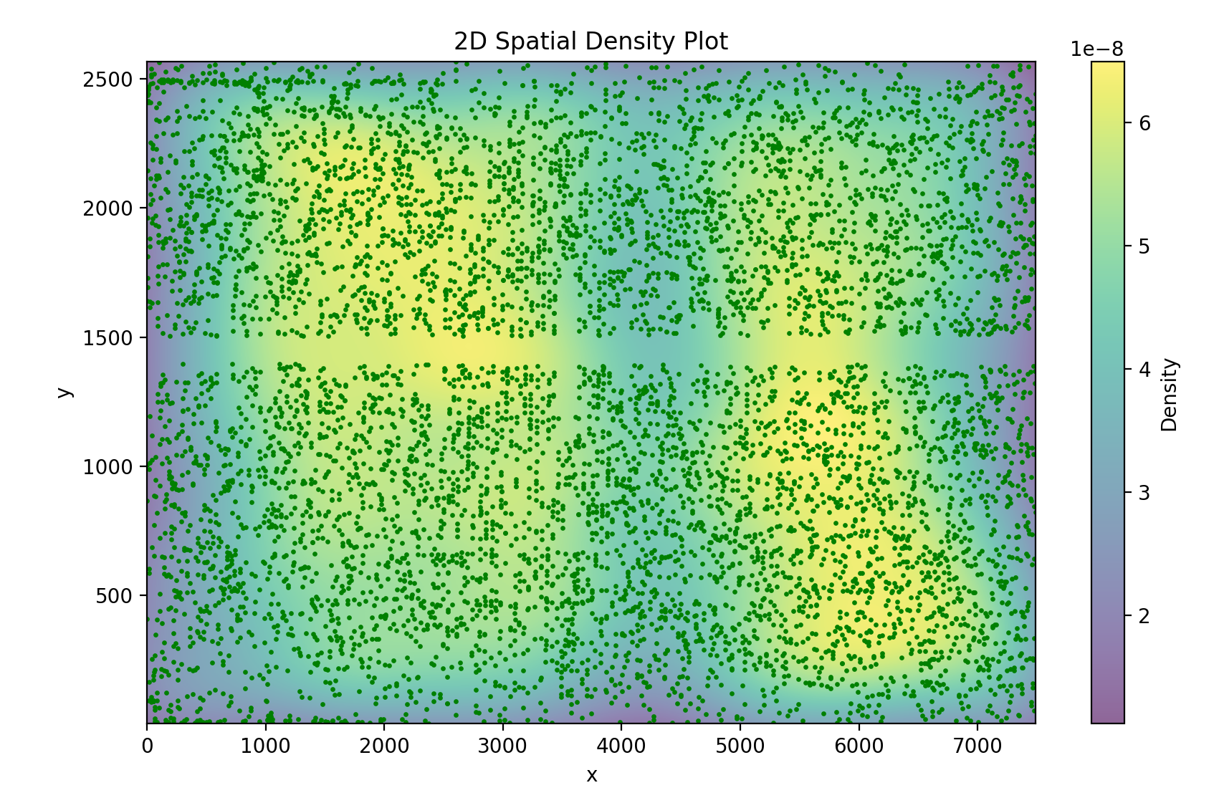

Discussion
Reasons of discrepancy
1. Cosmic Geometry: The no evolution model assumes a flat Euclidean universe. However, general relativity suggests the universe could be open or closed. Can be only discovered in a larger scale.
2. Galaxy Evolution: Over time, galaxies evolve, which means their brightness or number density might have been different in the past.
3. Large Scale Fluctuations: The distribution of galaxies in the universe is not perfectly homogeneous; it has large-scale fluctuations such as filaments, voids, and clusters. These fluctuations cause regions with overdensities or underdensities.
4. Inaccurate detection.
Density plot predicted by Gaussian KDE method

Slide 10
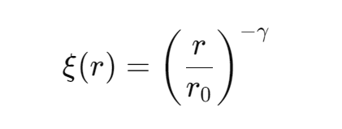
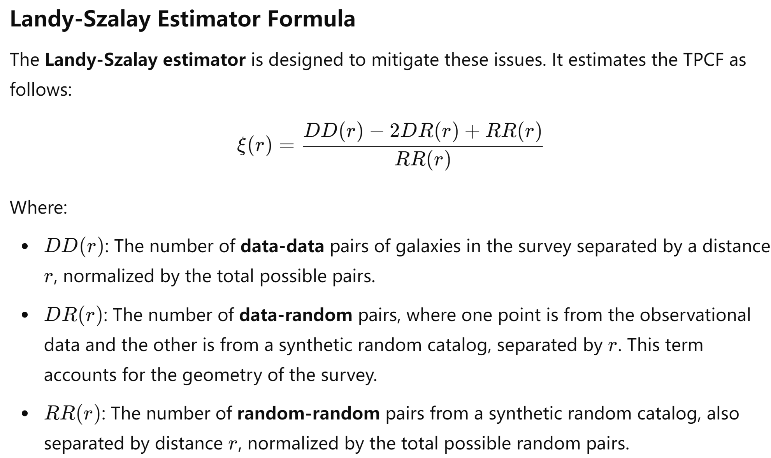
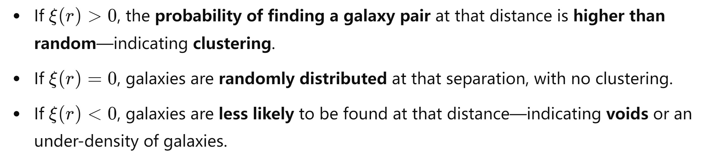
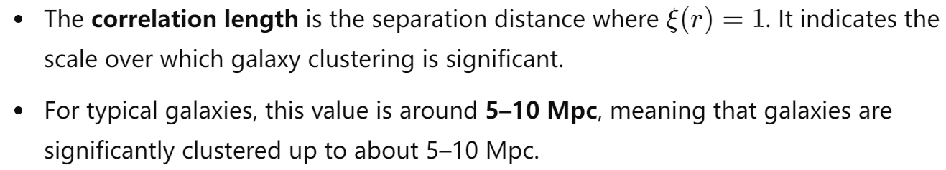
Discussion
Two-point correlation function
The TPCF measures the excess probability over random of finding two galaxies separated by a given distance, r.
The Peebles model is a theoretical model used to describe the two-point correlation function.

Slide 11
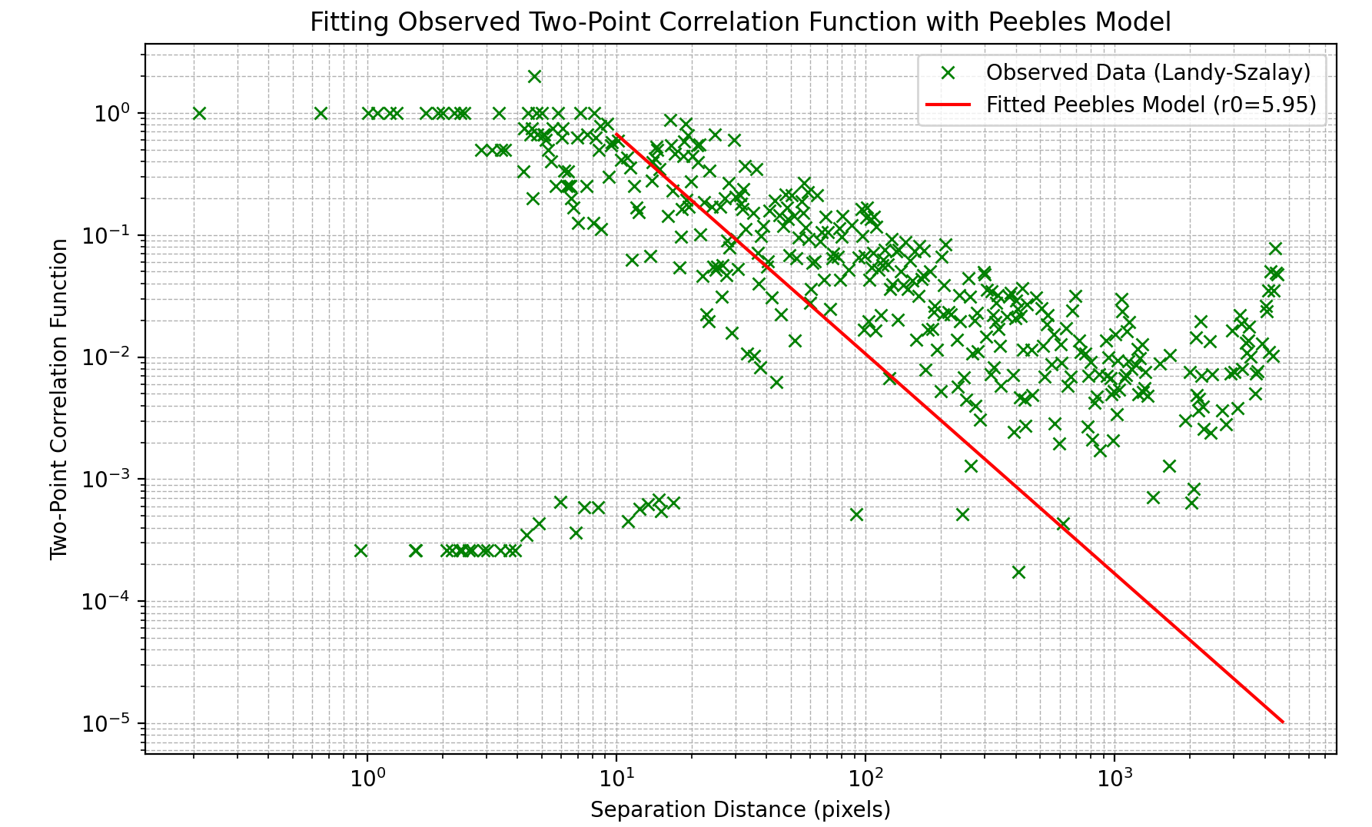
Discussion
Generate random distributed data and apply Landy-Szalay estimator. Analyze only the left side of the image to avoid the central mask.
Plot TPCF vs. separation distance of galaxies.
Fitting to Peebles’ model
Positive correlation indicates galaxies are clustered.
Good match with Peebles model suggests clustering is consistent with the large-scale structure of the universe.
Best-fit correlation length: r_0=5.95±3.23 (1.54 ± 1.05 arcseconds). Galaxies are more likely to cluster within a distance of approximately 5.95 pixels.
Beyond r_0, clustering strength drops below unity, reducing the probability of finding galaxy pairs. Clustering is limited to small scales, likely within the radius of individual galaxies or closely interacting pairs.
No significant clustering observed on larger scales, suggesting clustering reflects internal structures or close interactions rather than broader cosmic groupings.
Fit data using Peebles’ model.

Slide 12
Conclusion
Sources of discrepancy
Evaluating the two-point correlation function shows that galaxies in the image cluster, especially at small separations. The observed uneven distribution of galaxies may contribute to the discrepancy in the analysis, particularly when comparing to theoretical models or larger-scale surveys.
The analysis used an image covering only 4.8 deg² of the sky, this limited coverage prevents capturing a statistically significant sample of galaxies to represent the cosmic-scale distribution. The Cosmological Principle—the assumption that the Universe is homogeneous and isotropic—also only applies on cosmological scales.
Systematic errors in detection could also contribute to discrepancies in the analysis. Given that the general trend of our data aligns with the referenced paper, and the linear region is both long and stable, it suggests the presence of systematic errors in the measurement of galaxies.

Slide 13
Conclusion
Evaluation on method
May filtered out some valid data points when dealing with noisy points by the edge.
Zero Point Uncertainty: The zero point (ZPinst) from the FITS header has an uncertainty of 0.02, which, although small, can contribute to inaccuracies in magnitude calculation. Even small variations in the zero point can affect the faint end, where galaxies are more difficult to detect.
Automatically generated npix and total flux from Gaussian fitting were used without verifying their applicability to all galaxy shapes. This approach might not be suitable for irregular or extended galaxies, potentially leading to inaccuracies. Careful inspection is needed to ensure that the Gaussian fit and resulting parameters are appropriate for galaxies with varying morphologies.
Threshold Sensitivity: The detection threshold is set to 4 times the median absolute deviation (MAD) of the region. If the threshold is too high, faint sources might not be detected, leading to an underestimation of the total number of galaxies, which reduces the overall count in fainter magnitude bins.
Background Estimation Challenges: The use of Background2D with a (50, 50) bin size and a median background estimator can be insensitive to small fluctuations. For extended galaxies or regions with faint sources, this can result in over-subtraction or under-subtraction of the background, thereby affecting the flux calculation of faint galaxies.

Slide 14
Thank you
Local Universe Galaxy Survey: Magnitude and Density Profile
25/10/2024

